Slide 1
News Detector Fake or Not
The Predictive Pioneers
Basmala Ahmed
FCAI – Cairo University

Slide 2
Table of contents
01
02
03
04
Introduction
EDA
Project Overview
Exploratory Data Analysis
Exercises
Conclusions
About code
models

Slide 3
01
Introduction
Project Overview

Slide 4
Project Overview
Project Objective:
Classify news articles as fake or not fake.
Use NLP to Classify News Text.
Dataset:
Provided dataset with news text, title, date, subject, and class label (0 for fake, 1 for not fake).

Slide 5
02
EDA
Exploring Dataset, needed coloumns, missing values and corrupted rows

Slide 6
Datasets
Train Dataset
Test Dataset
Used to Train and Evaluate the models
Contains: 44919 Records
Used to test the model
Contains: 4496 Records

Slide 7
Dataset Coloumns
text
title
subject
News Text
News title
News subject
ID
class
ID enumeration
Indicator of Fake or not

Slide 8
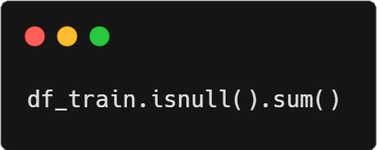
Identifying Missing Values
ID 4513
title 4492
text 4492
subject 4505
date 4505
class 4505
dtype: int64
Dropping Records with Missing class (Unneeded Record)

Slide 9
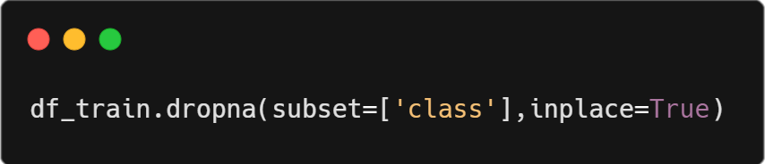
Dropping Corrupted Records
ID 0
title 0
text 0
subject 0
date 0
class 0
dtype: int64

Slide 10
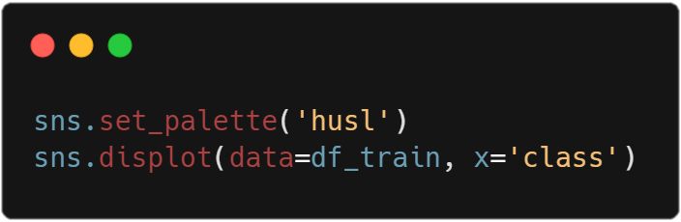
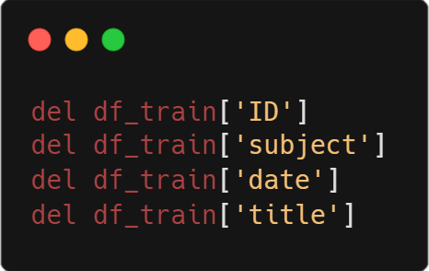
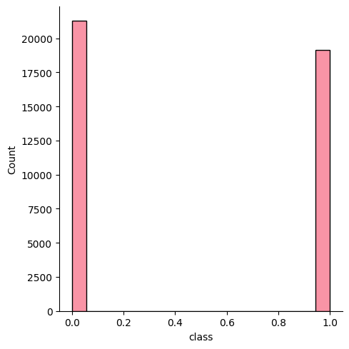
Dropping unneeded Coloumns
Visualizing Records

Slide 11
03
Data Preproccesing

Slide 12
Preprocessing Stages
1
Convert text to lowercase
Ensures uniformity by treating words like "Apple" and "apple" as the same.
2
Remove digits and punctuation
Eliminates noise that doesn't contribute to text meaning.
3
Tokenization
Breaks text into individual words (tokens) for easier processing.

Slide 13
Preprocessing Stages
4
Stopwords removal
Removes common words (e.g., "the", "and") that don't add significant meaning.
5
Lemmatization
Reduces words to their base form (e.g., "running" to "run") for consistency.
6
TF-IDF Vectorization
Transforms text data into numerical features that reflect the importance of words in the context of the entire dataset.

Slide 14
04
Model Selection
Finding the best Model

Slide 15
Model Selection
Used Models
Decision Tree
Logistic Regression
Gradient Boosting
Simple and visual model that splits data based on feature importance
Simple and interpretable model for binary classification.
Ensemble method for improving accuracy

Slide 16
Model Evaluation (Based on Model Evaluation)
99.7%
96.5%
99.5%
Decision Tree
Logistic Regression
Gradient Boosting

Slide 17
Classification Report
Decision Tree
Class | Precision | Recall | F1-Score | Support
0.0 | 1.00 | 1.00 | 1.00 | 4263
1.0 | 1.0 | 1.0 | 1.0 | 3820
Overall Accuracy: 1.00

Slide 18
Classification Report
Gradient Boosting
Class | Precision | Recall | F1-Score | Support
0.0 | 1.00 | 0.99 | 1.00 | 4263
1.0 | 0.99 | 1.00 | 1.00 | 3820
Overall Accuracy: 1.00

Slide 19
Model Evaluation (Based on Kaggle Submission)
99.6%
97%
99.8%
Decision Tree
Logistic Regression
Gradient Boosting

Slide 20
Thanks!

